Slide 1
Sons of God: Chosen to build the House of God
Eph 1:3-6; Jere 3:14-15
05/11/17
Notes:
Chosen – handpicked

Slide 2

1 Chro 29:1-3
Furthermore King David said to all the assembly: “My son Solomon, whom alone God has chosen, is young and inexperienced; and the work is great, because the temple is not for man but for the Lord God. Now for the house of my God I have prepared with all my might: gold for things to be made of gold, silver for things of silver, bronze for things of bronze, iron for things of iron, wood for things of wood, onyx stones, stones to be set, glistening stones of various colors, all kinds of precious stones, and marble slabs in abundance. Moreover, because I have set my affection on the house of my God, I have given to the house of my God, over and above all that I have prepared for the holy house, my own special treasure of gold and silver:

Slide 3
Ephesians 1:3-6
³ Blessed be the God and Father of our Lord Jesus Christ, who has blessed us with every spiritual blessing in the heavenly places in Christ, ⁴ just as He chose us in Him before the foundation of the world, that we should be holy and without blame before Him in love, ⁵ having predestined us to adoption as sons by Jesus Christ to Himself, according to the good pleasure of His will, ⁶ to the praise of the glory of His grace, by which He made us accepted in the Beloved.

Slide 4
Jere 3:14-15
¹⁴ “Return, O backsliding children,” says the Lord; “for I am married to you.
I will take you, one from a city and two from a family, and I will bring you to Zion
(Spiritual dimension of the Church).
¹⁵ And I will give you shepherds according to My heart, who will feed you with knowledge and understanding.

Slide 5
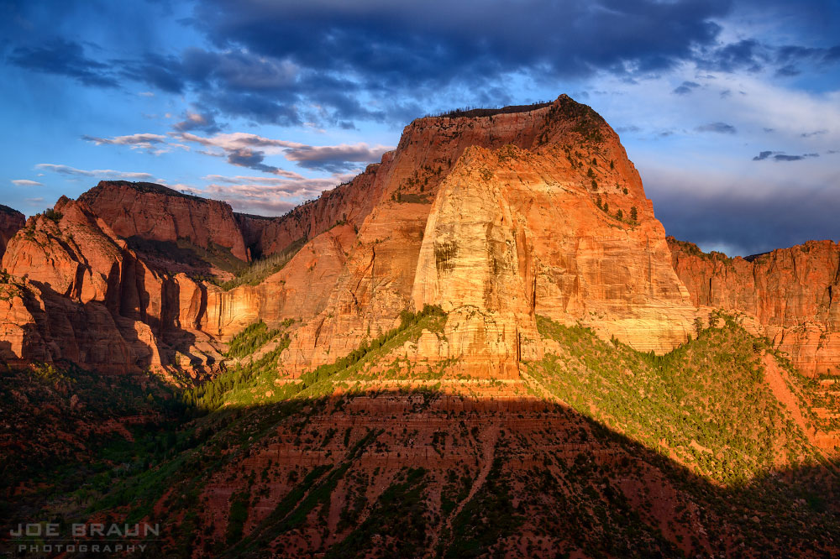
Heb 12:22-24
²² But you have come to Mount Zion and to the city of the living God, the heavenly Jerusalem, to an innumerable company of angels,
²³ to the general assembly and church of the firstborn who are registered in heaven, to God the Judge of all, to the spirits of just men made perfect,
²⁴ to Jesus the Mediator of the new covenant, and to the blood of sprinkling that speaks better things than that of Abel.

Slide 6

Heb 12:1-2
¹ Therefore we also, since we are surrounded by so great a cloud of witnesses, let us lay aside every weight, and the sin which so easily ensnares us, and let us run with endurance the race that is set before us,
² looking unto Jesus, the author and finisher of our faith, who for the joy that was set before Him endured the cross, despising the shame, and has sat down at the right hand of the throne of God.

Slide 7
Building God’s house
Loving what God loves
- His House & His Body/people
God blesses those who build His house, a place for God’s people to worship Him
- e.g. Centurion (Luke 7:1-10)
Co-labor: We are not only part of the House but we are also building the House
- a meeting place
- a dwelling place
- an outpouring place

Slide 8
1) Chosen sovereignly by God
John 4:1 - Therefore, when
the Lord knew that
the Pharisees had heard that
Jesus made and baptized more disciples than John

Slide 9
1) Chosen sovereignly by God
John 4:1 - Therefore, when
the Lord (Sovereign) knew that
the Pharisees (dead) had heard that
Jesus (new/present) made and baptized more disciples than John (old)

Slide 10
1) Chosen sovereignly by God
John 4:1 - Therefore, when
the Lord (Sovereign) knew that
the Pharisees (dead) had heard that
Jesus (new/present) made and baptized more disciples than John (old)
i. Old = tradition, familiar pattern, complacent. “let’s do how we have done it, that’s not how we have done it, we have not done it before”

Slide 11
1) Chosen sovereignly by God
John 4:1 - Therefore, when
the Lord (Sovereign) knew that
the Pharisees (dead) had heard that
Jesus (new/present) made and baptized more disciples than John (old)
ii. Dead = Religion, legalist “that does not makes sense, God can’t be that good”

Slide 12
1) Chosen sovereignly by God
John 4:1 - Therefore, when
the Lord (Sovereign) knew that
the Pharisees (dead) had heard that
Jesus (new/present) made and baptized more disciples than John (old)
iii. New/present: “Let’s move and build together with Him.”

Slide 13
2) Destiny written by God
Gen 28:11-19 Jacob’s encounter with God, transforms him (Jacob→Israel) so he can walks in the destiny written for him.
It does not matter what is in your past (who you were and what you have done).
What does God think of you?
Discover your destiny (LG)

Slide 14
3) Acts of faith to touch God
Mark 5:25-31 The faith of the woman made her confess and act according to her faith resulting in her healing
Acts of faith + encounter with God change circumstances that is limiting us from moving ahead.

Slide 15
Conclusion
God’s house is built by:
Ordinary people changed by God to be extraordinary:
  We are chosen to be extraordinary
  We need a God encounter to move in the extraordinary
  We need to move/act in faith to experience the extraordinary

